Slide 1
Scene Management

Slide 2

Notes:
Scene management is a strange beast – a scene varies from game to game, from developer to developer and sometimes even from scene to scene! But we can start by thinking of them as something that refers to a substantial section of a game, featuring sound, graphics and logic. It could be a complete level for a platformer, including platforms, physics, background objects, the player character, NPCs, sounds and music or it could be a track for a racing game; with audience, track features, weather effects, cars and all the rest.
The essential property of a scene is that it is completely self-contained, in that it contains all the assets necessary to present a coherent and playable scenario. As such, the scene not only determines the assets that must be loaded and unloaded but must also ensure that they are consolidated into a playable whole.
The scene manager is the sub-system (component or class) that encapsulates this behaviour.

Slide 3

Scene Graph
Depth Sorting
Time Keeping
Notes:
A lot of the functionality that drives a scene manager is game dependant – it’s up to you as developers to decide what your scene manager should or should not do. However, there are a few core things we can consider for a 2D scene manager:
Scene graph for expressing object positions and relations
Depth Sorting to determine occlusion of scene objects and to emphasize their distance from the camera
Time Keeping – that is, the ability to maintain a scenewide concept of time
Note that a lot of what we’ll cover in this session applies to a 3D scene manager, but we won’t go into the exact differences – I’ll leave that up to you as a research exercise!

Slide 4

Notes:
So our rendering system allows a developer to draw any loaded graphical item at any valid position on the screen – which at first touch seems like a more than powerful enough system to allow us to produce any number of game scenes without having to perform any further management, so it can be tempting to consider proper scene management to be as a luxury, or worse – completely unnecessary! It’s not hard to see why; each graphical entity can already be positioned where required and objects in motion are simply items whose position changes at a specified speed – but that’s a simplification of the hidden complexities.
These complexities usually start to emerge when we realise that objects in a scene do not exist in isolation, but in a relationship – each in relation to every other. While every entity has its own position, scale and orientation, these values are not entirely independent of the other objects in the scene. Which means that the movement of one object may nor may not directly affect the position of another.

Slide 5
Road
Pos(x, y)
Car
Pos = ParentPos + LocalPos
Passenger 1
Pos = ParentPos + LocalPos
Passenger 2
Pos = ParentPos + LocalPos
Notes:
Consider a game with a scene that features a road, on that road is a car and inside the car is a driver and a passenger. All these entities exist in a relationship in terms of their position in the scene and these relationships involve a certain degree of dependency and interdependency. As the car moves along the road, the passengers inside are expected to follow, not to remain motionless as the car moves away without them. This is because the position of the passengers and their position inside the car is, to some extent, dependent on the position of the car. The passengers can move around inside the car without affecting the position of the car, but the movement of the car along the road affects the position of the passengers in the scene.
A scene graph is a hierarchical expression of the transformations (position, rotation and scaling) of objects in the scene, with the transformations of high-order objects cascading down additively to lower-order objects. Or, each item in the graph can move independently if its parent, but the movement of the parent affects all child items.

Slide 6

class INode
{
public:
virtual void setParent() = 0;
virtual INode *getParent() = 0;
virtual void setTransform(Transform* newTrans) = 0;
virtual Transform *getTransform() = 0;
virtual bool AddChild(INode *child) = 0;
virtual bool RemoveChild(int id) = 0;
virtual void PreRender() = 0;
virtual void Render() = 0;
virtual void PostRender() = 0;
};
Notes:
So to represent a state graph we can have a base “Node” class (or interface) that we can inherit from to produce a range of Node types: transform and geometric are fairly common, but we might also include a camera node (that stores information specific to a camera) and a collision node for a physics system.
The transformation node stores a representation of the objects position: it could be a matrix or a series of vectors representing 2D offsets from the parent node. When we want to render the node at its position, we can work through from the root node and concatenate together all the transformations until we get to the transformation node belonging to the leaf to be rendered – at which point we have it’s exact position in space in relation to the origin of the world or scene.
OGRE3D offers up a pretty good example of a scene graph node structure that’s also fairly well documented…

Slide 7
Array or Linked List
Directed Acyclic Graph
Trees (Quad, Oct, BSP, kd)
Notes:
For small scenes, we can store all the nodes in an array or linked list – displaying the nodes becomes a simple matter of iterating the nodes one by one. The concept of traversing the scene graph is the key to the power of applying operations to scene graphs; a traversal typically consists of starting at some arbitrary node (normally the root), applying the operation(s) and recursively moving down the tree to the child nodes until a leaf is reached.
Consider a render operation that takes transformations into account when travelling down the hierarchy, a pre-render operation is called – if the node is a transformation node, it adds its own transform to the current transformation matrix. Once the operation finishes traversing all the children of a node it calls the post-render operation and the transformation node undoes the transformations.

Slide 8

Notes:
In 2d, we would typically render starting at the root node and then recursively drawing the child nodes. The leaves represent the most foreground objects, since we’re proceeding in a back to front order, the close objects simply overwrite further ones. This is known as the painter’s algorithm. A 3D system generally uses a depth-tested approach: it’s more efficient to draw the closest objects first, since farther objects often only need to be depth-tested instead of actually rendered – because they are occluded by nearer objects. Even with our 2D approach, we can make use of depth sorting and layers to ensure our system can efficiently re-order the entities to be drawn. A layer is analogous to layers in photoshop; they’re groupings of objects that are drawn on the same “plane”. Though we will still want them to be ordered within those layers.
This can be achieved by sorting our render list based on a given value (typically the z-order), the scene manager should make this straight forward by allowing us to easily sort our entity list – depth sorts such as this are often undertaken using the radix sort algorithm (which is handy for sorting not only on depth, but also on render states).

Slide 9
Take the least significant bit of each key
Group the keys based on that bit, but keep the original order
Repeat the grouping process with each more significant bit
170, 45, 75, 90, 802, 2, 24, 66
Notes:
Radix sort:
A radix sort, unlike say bubble sort or merge sort, does not do direct comparisons between values, instead it uses “buckets” of values (the buckets represent values between 0 and 9). The algorithm goes through the following steps: (Step 2 is usually done using bucket or counting sorts.)
We can do this fairly straight forwardly using queues – we have 10 queues, and into each we push the values based on the current significant bit. The queues are then dequeued back into an array of integers, in increasing order. We repeat this process for every bit (we can find the largest bit value by iterating our array and finding the largest value).
170, 45, 75, 90, 802, 2, 24, 66

Slide 10
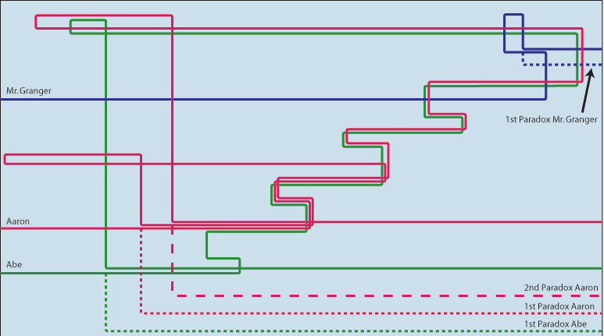
Real Time
Notes:
Time keeping: There are several different forms of “time” that we can track in a game engine (via our scene manager). So it’s helpful to think in terms of abstract timelines – where a timeline is a continuous, one-dimensional axis whose origin can lie at any arbitrary location relative to other timelines in the systems. This can be as simple as a simple variable that stores absolute time values.
One of the most important timelines to consider is the “Real” timeline – based on the CPU’s high resolution timer. The origin of this timeline is set to when the CPU was last powered on or reset (as that’s when the CPUs timer will have reset too), it measures time in CPU cycles, which we can translate into units of seconds by multiplying them by the frequency of the high-resolution timer on the current CPU.

Slide 11
Real Time
Game Time
Local Time
Notes:
Another timeline is “Game time” – that is independent of the real timeline, allowing us to easily handle things like pausing the game (we can’t pause the CPU after all, so if we rely on real time for everything, we struggle to find a nice approach to this) or implementing something like slow motion – which we can achieve by updating the game clock slower than the real-time clock.
We can also define local timelines, audio or animation clips might have a local timeline that has an origin that coincides with the beginning of the clip, this local timeline measures how time progressed when the clip was originally authored, when it’s played back in game, we don’t need to play it at the original rate – we might want to speed it up or slow it down.

Slide 12
Real Time
Game Time
Local Time
Notes:
We can visualise these effects as a mapping between the local timeline and the global timeline (either game or real). To play an animation clip back at its originally authored speed, we map the start of the animations local timeline onto the desired start time along the global timeline. To play it back at a different speed, we simple track a time scale factor (or playback rate) in addition to the clips global start time.
So here our R value is 2, scaling t by 1/R gives us 0.5 – so it’s playing twice as fast.
If we set R to -1, then we reverse the clip completely.

